Slide 1

Design Thinking
A Hands-on Approach
A practical workshop to apply real techniques of design thinking.
Notes:
Like the real world, for today’s exercises:
You won’t have enough time
You may not always know what to do
You will have to make decisions
You will have to work with others
Most important: You will have to put yourself in someone else’s shoes, to understand them, and their situation.

Slide 2
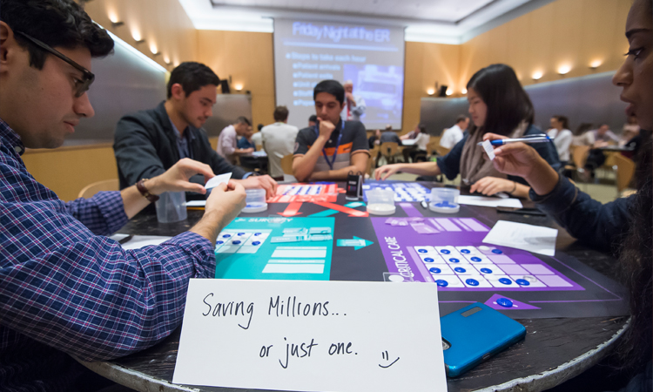
Post ”Friday Night at the ER”
Designing the “Patient Experience”
Notes:
From the “Friday Night at the ER” session you learned about systems thinking, which is about seeing how interrelated parts come together to form a system by interacting with one another over time.
We will shift from systems thinking now into design thinking. Again the best way to learn about something is through doing. We will be exploring aspects of design thinking through the same case study, the Emergency Room. We will focus on the ”Patient Experience”.

Slide 3

Todays Objectives
Experience ‘Design Thinking’ in action
Practice techniques to get a feel for the process
Provide a basis of knowledge to build, grow and learn

Slide 4
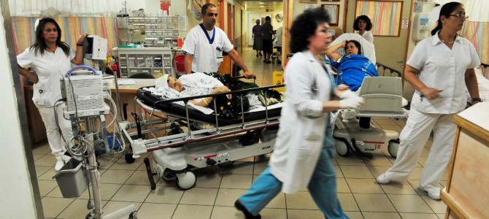

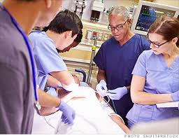

Exercise 1
The ”Patient Experience”
Design a new “Patient” experience for the ER. Focus on ONE (1) problem you feel will have a major impact.
10 Minutes
Notes:
Independently (on your own)
Capture the problem you will focus on.
Capture a design in a way that conveys how the problem will be solved.
Be ready to describe both the problem and the solution.

Slide 5
Exercise 1- Worksheet

Slide 6

The FALSE START
When an organization designs solutions with insufficient understanding of the problem domain.
Notes:
Typically this is how most organizations treat projects. Most organizations jump to solutions immediately without a clear understanding of the problem landscape, the scope and impacts of the problem. Without a systematic approach, and a clear understanding of the problem organizations often jump to solutions.
Commonly know as the “False Start” in design circles. Watch for symptoms of the false start in your projects.
Symptoms include:
“But we already have the technology it will just need to be repurposed…”
“Our team already started on a solution, we can’t just throw it away…”
“Research will just slow us down…”
“We have an expert on staff who knows about this issue…”

Slide 7
Design Thinking?
Learn how!
EMPATHIZE
IDEATE
TEST
Observe, engage, and immerse in the problem in order to understand.
Transition from understanding the problem, to creating solutions. Driven by “how might we…”
Test and refine your point-of-view.
DEFINE
PROTOTYPE
Develop a point of view that inspires ideas, but is testable.
Build to think deeply and start a conversation.
Notes:
Design Thinking is a system devised to help us overcome our own human bias’s
Bias’s to jump to solutions.
Bias’s to make decisions based on incomplete data.
Bias’s towards immediate action.
Bias’s towards inaction (keep analyzing)
It’s a system to help us be mindful to empathize, define, ideate, prototype, and test our ideas.
For those who want to learn more here are some links:
https://dschool.stanford.edu/resources/design-thinking-bootleg
https://www.ideou.com/pages/design-thinking-resources

Slide 8

Exercise 2
Empathy Interviews
Find 1-2 persons in the group who have had a recent OR memorable ER experience. Interview each person about that experience.
10 Minutes
Notes:
Empathy is learning how another person feels.
I like to say we are putting ourselves in their shoes.
Deep understanding starts with empathy, and empathy starts with listening.

Slide 9
Exercise 2 – Notes from Interviews
Person #1
Person #2
Notes:
Tell me about your experience at the Emergency Room?
How long ago was it?
What type of problem were you facing?
What prompted you to feel the Emergency Room was your best choice for care?
How would you describe your experience at the ER?
Were you satisfied with the outcome of your visit?
Were you satisfied with the treatment you received?
Were you satisfied with the overall experience?

Slide 10

Exercise 3
Dig Deeper
Continue the interviews by digging deeper. Ask probing questions:
How did the experience make you feel?
Why did you feel that way?
What impacted you the most about the experience?
10 Minutes
Notes:
It is not enough to simply know how a person feels, it is important to understand why?
Only by digging deeper can one truly understand a problem.
I suggest that you can’t get to the true reason a person feels a certain way until you have asked them why 3 times.
The importance of (3) three whys, is this; most people will provide the superficial answers unless you keep probing.
Dig deeper!

Slide 11
Exercise 3 – Deeper Insights
Person #1
Person #2
Notes:
What prompted you to feel the Emergency Room was your best choice for care? Why?
How would you describe your experience at the ER? Why do you feel that way?
Were you satisfied with the outcome of your visit? Why do you feel that way?
Were you satisfied with the treatment you received? Why do you feel that way?
Were you satisfied with the overall experience? Why do you feel that way?

Slide 12
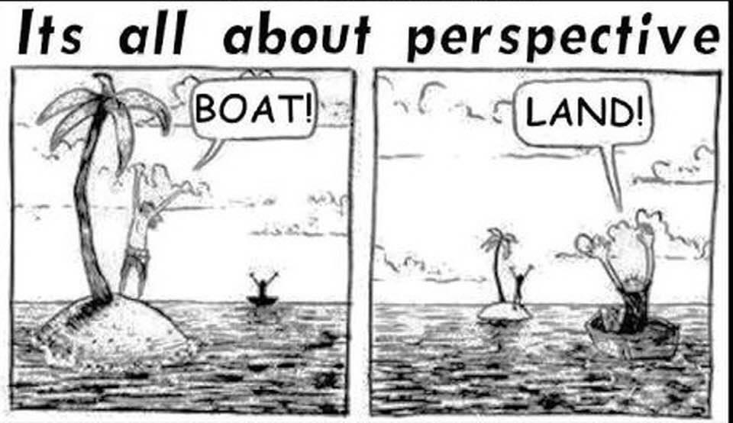
Exercise 4
Explore Perspectives
From the videos, capture notes to highlight how others perceive the ER experience.
15 Minutes
Notes:
Everyone has a perspective.
Sometimes perspectives can be at odds.
What experiences, and knowledge contribute to a perspective?
The key to understanding a perspective is understanding context.
Next I will be showing a few videos that provide different perspectives on the ER experience.
For each perspective please capture:
What do they consider important for the ER experience? Why?

Slide 13
Exercise 4 –Perspectives
Hospital Admins
Doctor
Family
Patient

Slide 14

Exercise 5
Develop a Point of View
Take 5mins to craft a personal point of view. Share your point of view with the group. Find a common ground on a single problem and craft the “group point of view”
20 Minutes
Notes:
FIRST do this independently (on your own)
SECOND come together as a group to discuss each point of view.
Questions to help build consensus
We use the point of view format in order to keep track of differing points of view.
WHO: _______________________________________________(describe the person )
NEEDS A WAY TO _____________________________________(describe their need)
BECAUSE: _________________________________________ (describe the reason for their need)

Slide 15
Exercise 5 – Develop a Point of View
Target person:
Needs a way to:
Because:

Slide 16
The Break!
Take 15mins

Slide 17
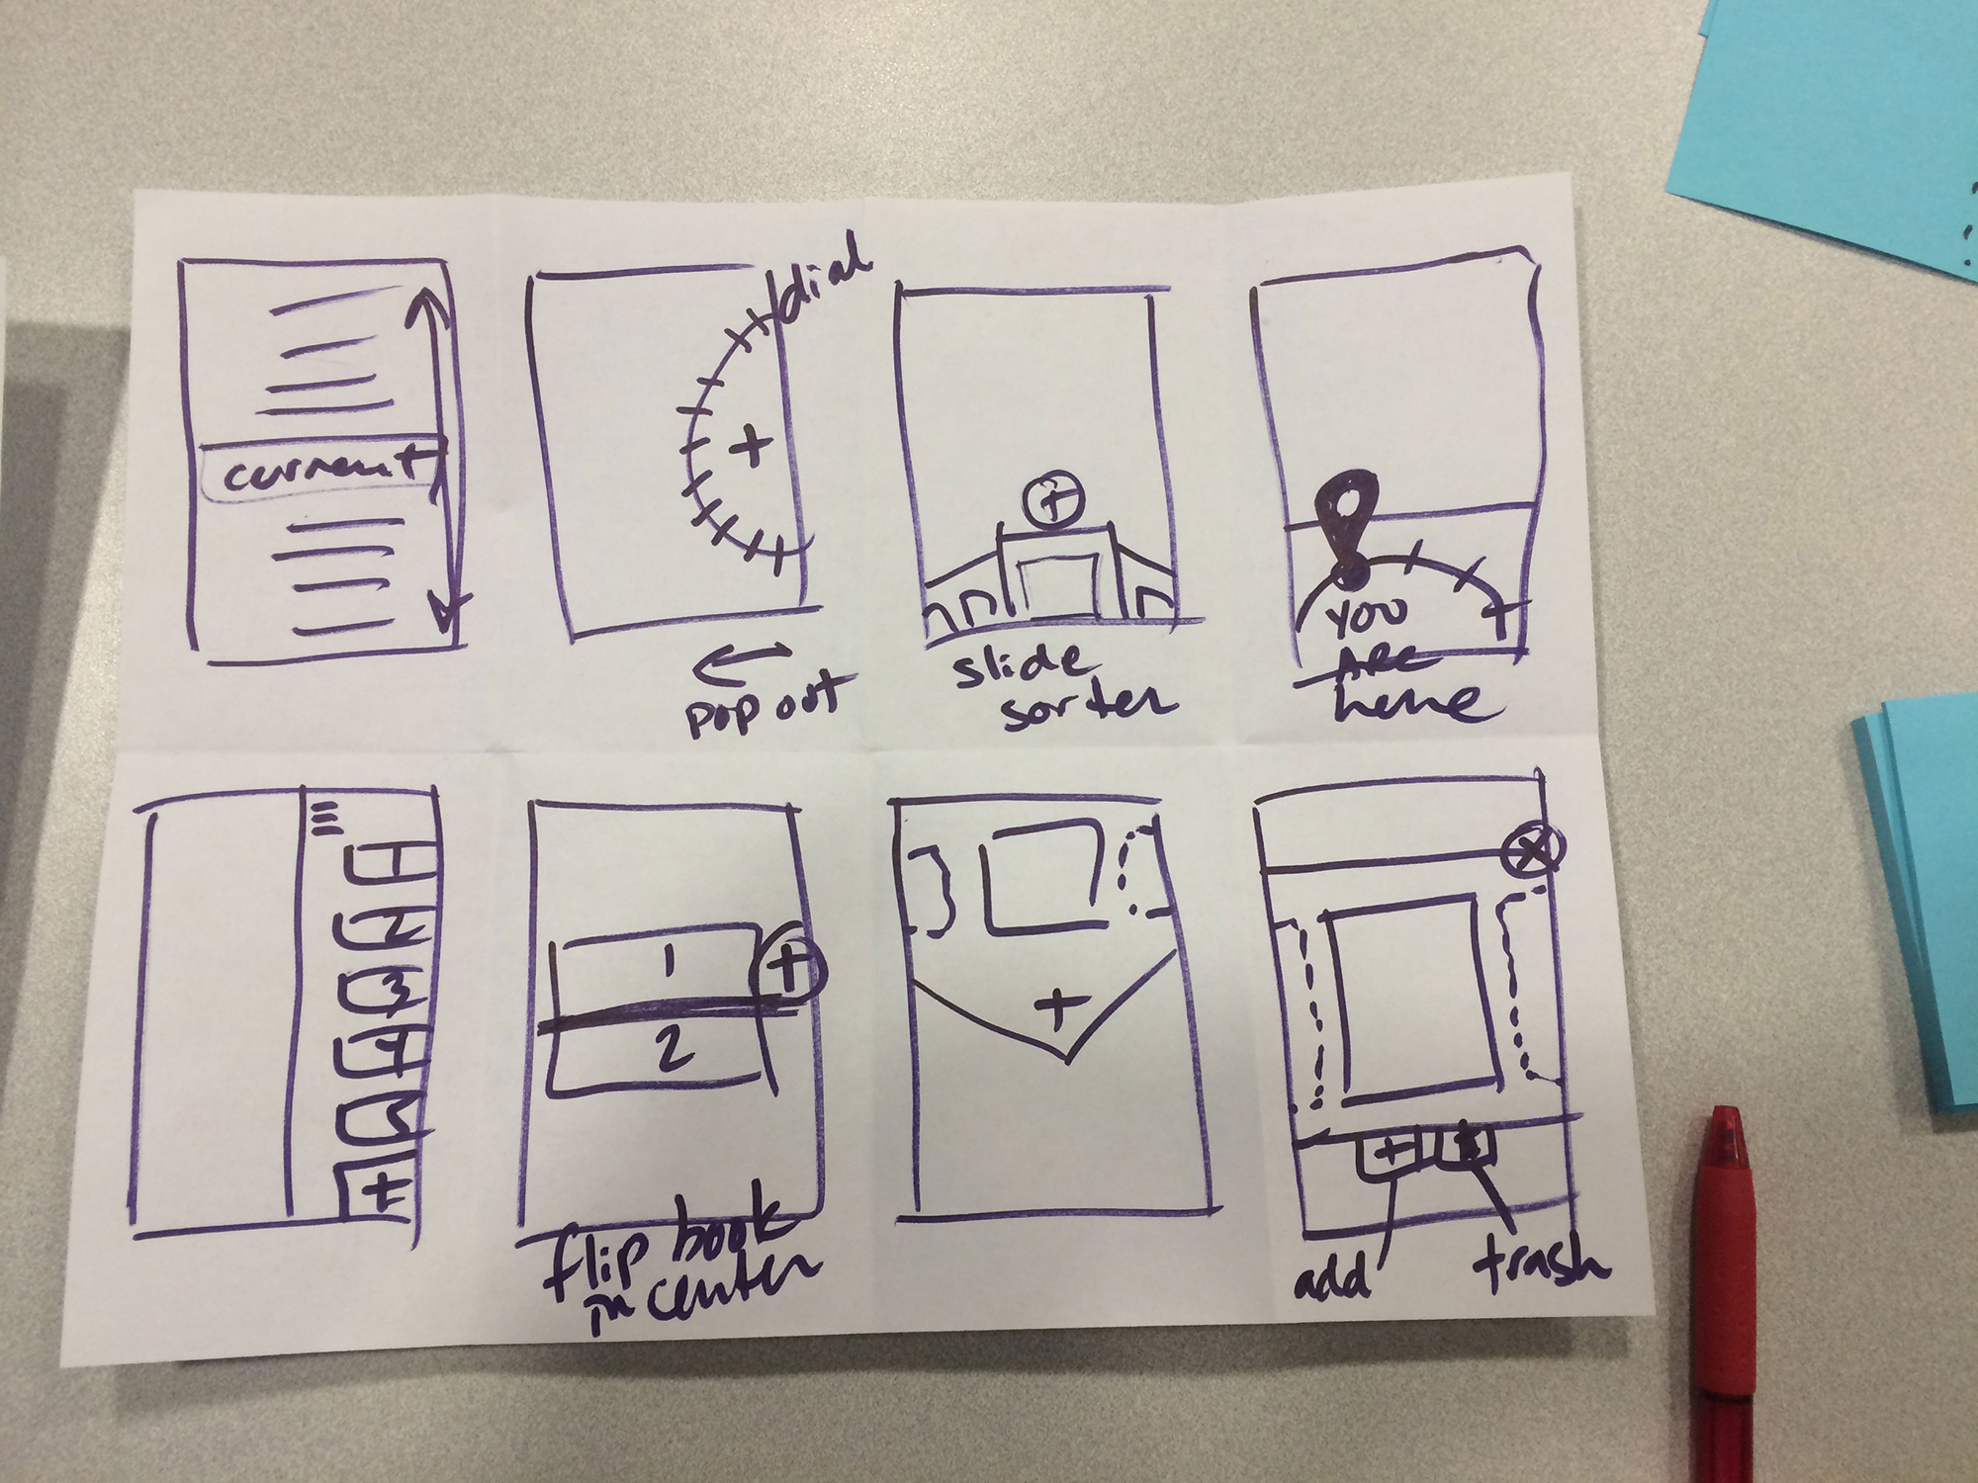
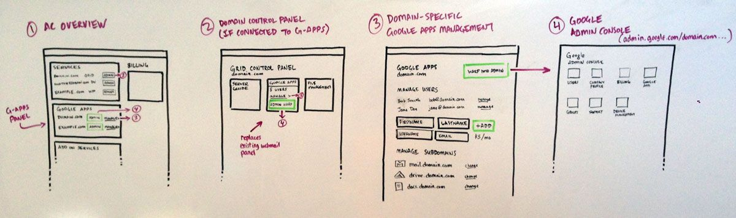
Exercise 6
Ideas!
Sketch at a minimum Five (5) ideas to solve the problem.
10 Minutes
Notes:
We say sketch – what we mean is capture.
No one needs to be an artist.
You simply need to be able to capture your ideas in some form.
This could be in pictures, words, or some combination.

Slide 18
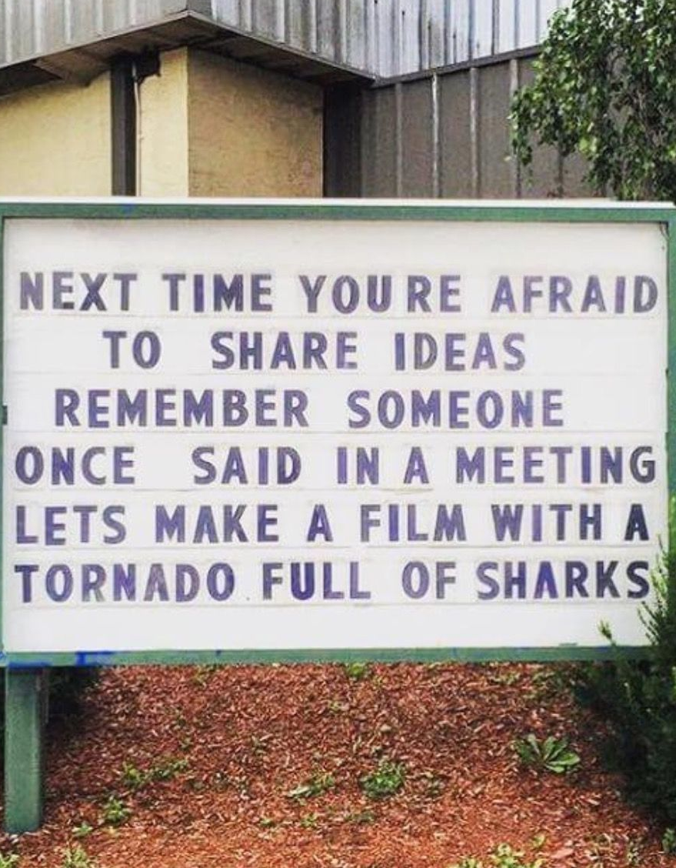
Exercise 7
Share Your Ideas
Each person in the group gets up to 5 mins to share their ideas with the group. Each idea gets posted.
20 Minutes

Slide 19
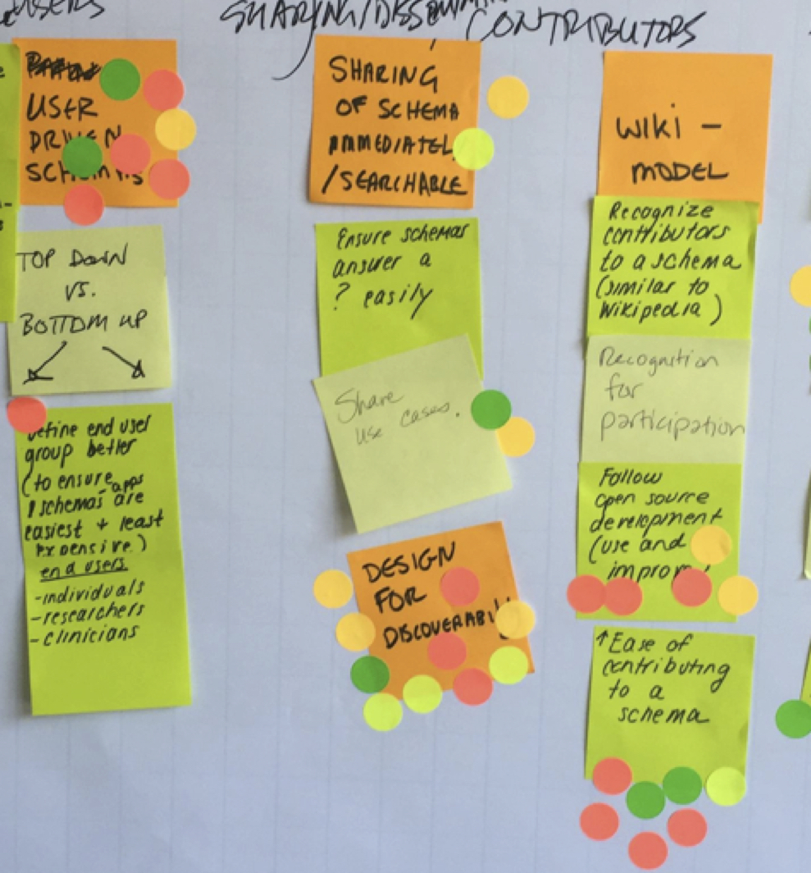
Exercise 8
Silent Vote
Each member of the team gets 3 voting dots. They can use them as they see fit to vote on one or many of the ideas they feel will best solve the problem.
5 Minutes
Notes:
You can apply all of your votes to a single idea, or spread your dots around to separate ideas.
Remember this vote is silent, no need to describe why you voted a certain way.

Slide 20
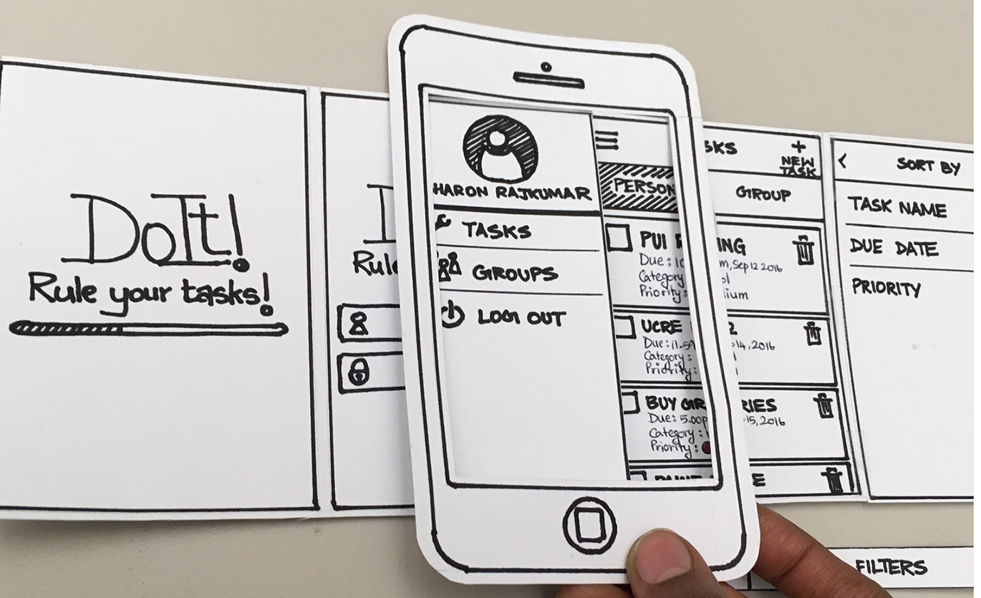
Exercise 9
Build Something
Discuss as a team the top ranked idea and determine the best way to build something that can be tested (cause you will be doing that next)
30 Minutes
Notes:
Don’t get caught up with the aggressive time period.
Nothing has to be perfect.
Build something.
Build anything.
Could be a scenario with a couple of pictures
Could be a role play where your team acts out a situation with a participant
Could be a paper-based system, where someone plays the role of any needed technology

Slide 21
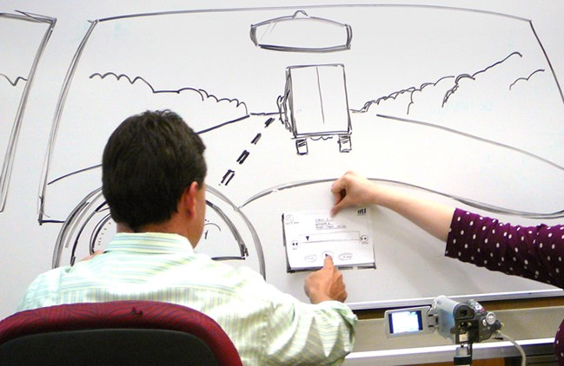
Exercise 11
Testing
Using existing stakeholders to evaluate the ideas, test the solution.
20 Minutes
Notes:
Use as test subjects the first two(2) people who had an recent ER experience that your group interviewed?
Testing approach:
“Today we will be exploring a way to improve the ER experience for you the patient.
We’d like to get your feedback on an early prototype.”
Things to try during testing:
Ask the Testing Participant to perform an action
Ask the Testing Participant for feedback (What do you think of X?)
Ask them to compare this prototype to the existing solution.
Is there anything you can suggest to improve the prototype.

Slide 22
Exercise 11 –Testing
What worked?
What didn’t work?
Questions?
New ideas!

Slide 23
The Debrief
What Did You Learn?

